Slide 1
File Handling , Logging and Asynchronous Programming in C#
Presented By : PRAYAS MAZUMDER
On : 01.08.2025 (Friday)
Company name : WTW

Slide 2
Content
1
File Handling in C#
2
Logging System in C#
3
Asynchronous Programming in C#

Slide 3

File Handling in C#

Slide 4

Definition
Common Classes in File Handling from System.IO namespace
File : Provides static methods to create, copy, delete, move, and open files.
FileInfo : Provides instance methods to do the same as File, but with more control.
StreamReader : For reading text files.
StreamWriter :For writing text to files.
Directory : For creating, moving, and enumerating through directories.
DirectoryInfo: Similar to Directory, but object-oriented.
File handling in C# refers to the process of performing operations like creating, reading, writing, appending, and deleting files using the classes provided in the ‘System.IO’ namespace.

Slide 5
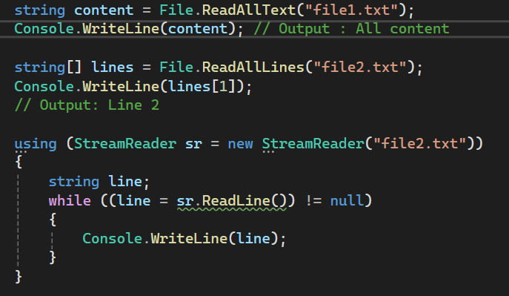
Basic File Reading Operations
ReadAllText → Read Entire File as a String
ReadLines() → Reads File Line by Line
ReadAllLines → Read All Lines at Once as an Array
StreamReader : Line by Line check

Slide 6
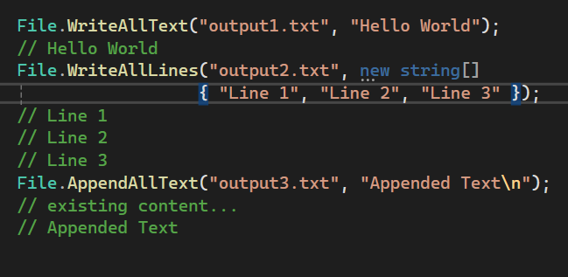
Basic File Writing Operations
File.WriteAllText()→ Writes a string to a file (overwrites if file exists).
File.WriteAllLines → Writes an array of strings as separate lines in a file.
File.AppendAllText(): Appends a string to the end of a file.

Slide 7
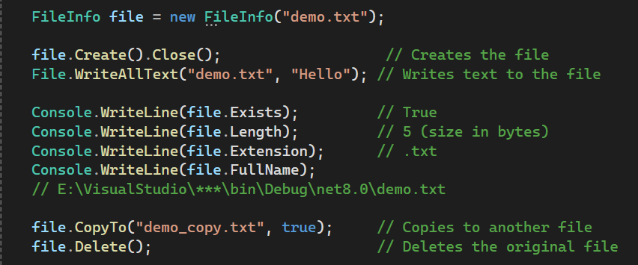
FileInfo Class
Provides properties and instance methods for the creation, copying, deletion, moving, and opening of files, and aids in the creation of FileStream objects.
This class cannot be inherited.

Slide 8
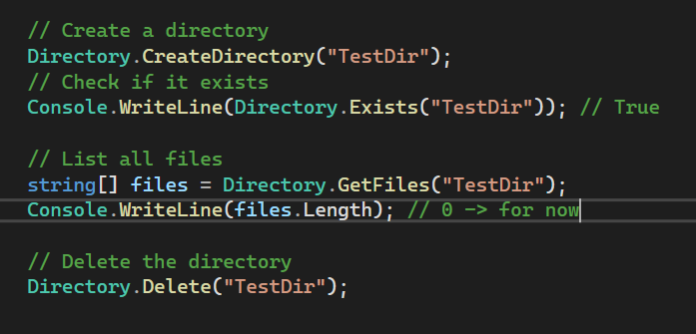
Directory Class
Exposes static methods for creating, moving, and enumerating through directories and subdirectories.
This class cannot be inherited.

Slide 9
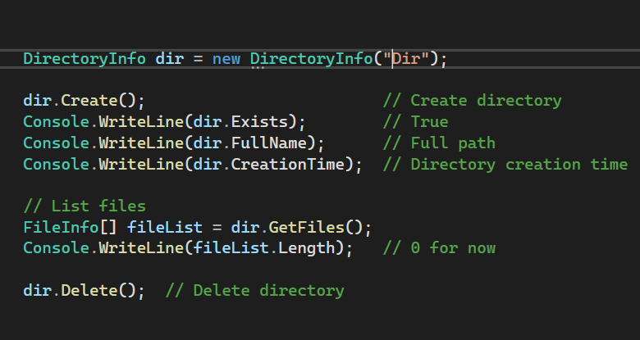
DirectoryInfo Class
Provides instance methods and properties for directory manipulation.
Instance based
This class cannot be inherited.

Slide 10
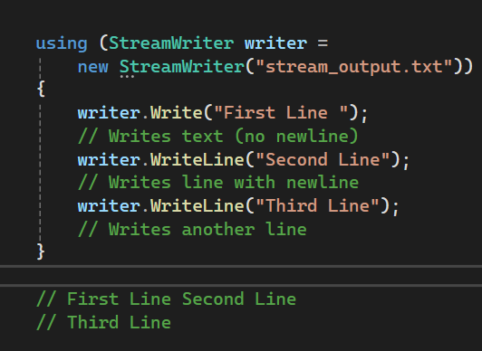
StreamWriter Class
Used to write text to a file, line by line or in blocks, with better control than File.WriteAllText.
Use Write() for inline text, WriteLine() for new lines
Must be disposed — use using block
Good for writing large files or line-by-line data

Slide 11
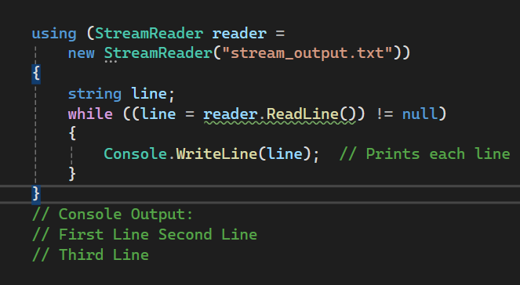
StreamReader Class
Used to read text from a file, line by line or all at once, with fine control.
Use ReadLine() to read line-by-line.
Use ReadToEnd() to read full content
Must be disposed — use using block
Good for writing large files or line-by-line data

Slide 12
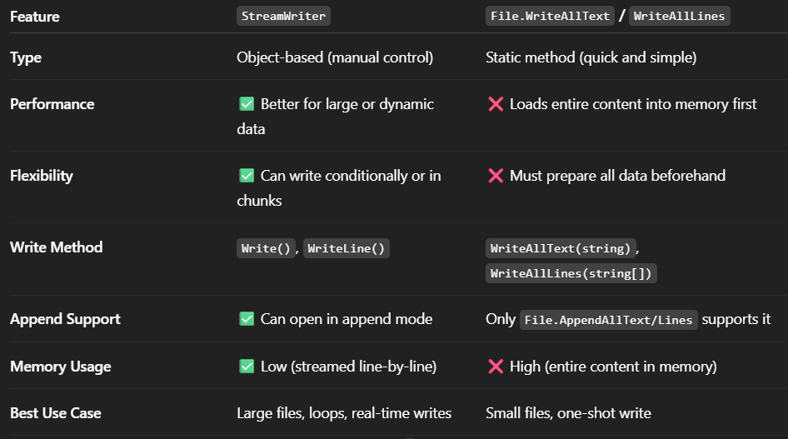
StreamWriter vs WriteAllText/WriteAllLines

Slide 13
Some best coding practices while working with files✅
Always check if file or directory exists before accessing it
Use using statements to ensure proper disposal of file streams
Handle exceptions with try-catch to avoid crashes
Prefer absolute paths in critical or production applications
Use the Path class to safely build file and directory paths
Validate user input when accepting filenames or paths

Slide 14
Logging System in C#

Slide 15
What is Logging System ?
A logging system in C# is a way to record information about the execution of a program : such as errors, warnings, informational messages, or debugging details—so that developers can track what happened during runtime.
This helps with ⇒ 1. diagnosing problems,
2. monitoring application behavior
3. auditing.

Slide 16
Why Logging is needed? (if we can always print errors in console🧐)
It might seem like Console.WriteLine() is enough to show messages, but logging systems offer a lot more than just printing text to the console.
It supports different log levels(severity) like debug , info , warning , critical etc and we can filter out logs based on these levels
While Console.WriteLine() writes to Console only , logs can be written in Files , Remote Servers , Databases , Event Logs etc.
Structured Logging : Advanced logging lets you add metadata and structured data to your logs, which helps in searching, filtering, and analyzing logs later.

Slide 17
Structured Logging :
Structured logging is a method of logging where log entries are written as data with structure, rather than just plain text messages. This makes it easier for machines and log systems (like ELK Stack, Seq, Datadog netc.) to parse, filter, and analyze log data. It captures context in queryable format like JSON .
Structured logging = logs as structured data (key-value pairs).
Makes logs machine-readable and searchable.
Improves analysis, filtering, and debugging.
Especially powerful in distributed or cloud applications.

Slide 18
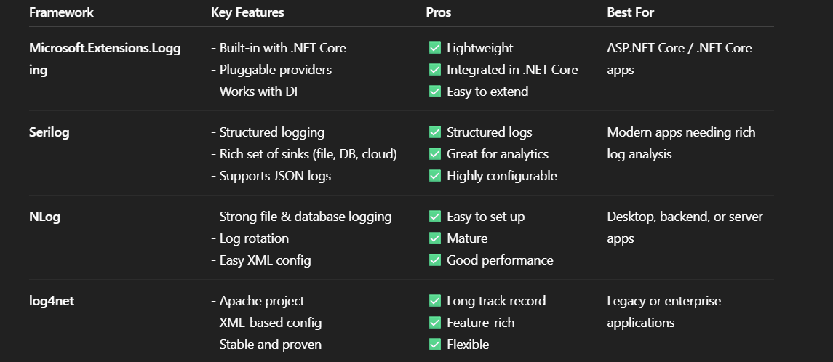



Logging Frameworks in C# :

Slide 19
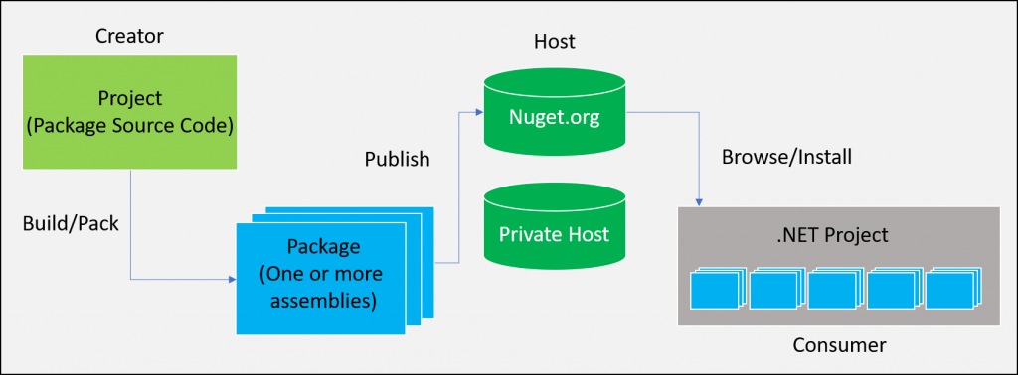
NuGet Packages
NuGet is the package manager for .NET. It allows developers to create, share, consume, and manage third-party libraries (called packages) in .NET projects.
A NuGet package is a .nupkg file — essentially a ZIP file –> that contains compiled code (DLLs), metadata(.nuspec) and other content files needed by a .NET project.

Slide 20

Serilog
Serilog is a structured logging library for .NET. Unlike traditional logging tools that write plain text logs, Serilog captures structured data, which makes logs easier to filter, search, and analyze .
Instead of just writing strings, Serilog stores logs as structured data (key-value pairs), making it machine-readable and queryable.
Sinks : A sink is a destination for logs. Serilog supports a wide range of sinks including Console, File, JSON files, Seq, Application Insights, SQL Server, and more, allowing flexible log routing for various environments.
Note: Seq (as a sink) provides a searchable, web-based UI to explore them. In short, Serilog is the producer; Seq is the viewer and analyzer.
Ask ChatGPT

Slide 21
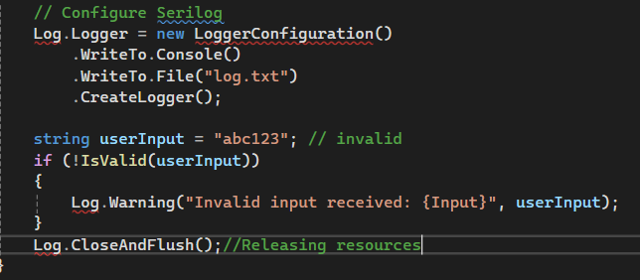
Serilog
Here's a very short and straightforward C# example that uses Serilog to log an invalid input:
Output : [Warning] Invalid input received: abc123
In log.txt and in Console

Slide 22
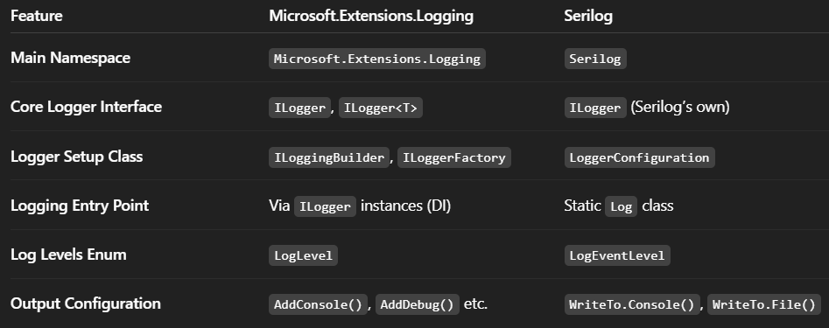
Microsoft.Extensions.Logging vs Serilog

Slide 23
Asynchronous Programming in C#

Slide 24
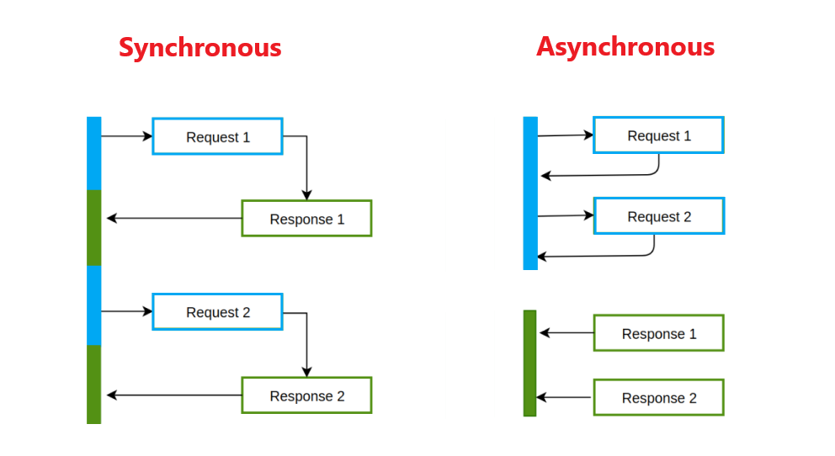
Asynchronous Programming
Asynchronous programming in C# is a way to execute tasks without blocking the main thread, allowing applications (especially UI or server applications) to remain responsive or handle multiple operations efficiently.
Synchronous: Code runs line by line. Each line waits for the previous one to finish. While , Asynchronous: Code can run "in the background." While a task is waiting (e.g., for I/O or network), the program can continue doing other things.

Slide 25
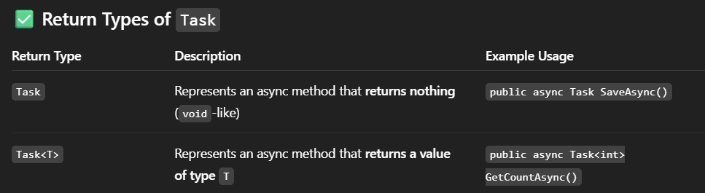
Thread vs Task vs Task<T> 💡
In C#, a Thread represents a low-level unit of execution that runs independently and provides full control over its lifecycle, such as starting, pausing, or stopping. It's resource-intensive and best used for long-running, CPU-bound operations where we need manual control.
A Task is a higher-level abstraction used for asynchronous programming and parallelism. It is more efficient, typically managed by the .NET ThreadPool, and suited for short-lived or background operations.
Unlike Thread, a Task does not create a new thread by default but reuses threads efficiently.
Task<T> is a generic version of Task

Slide 26
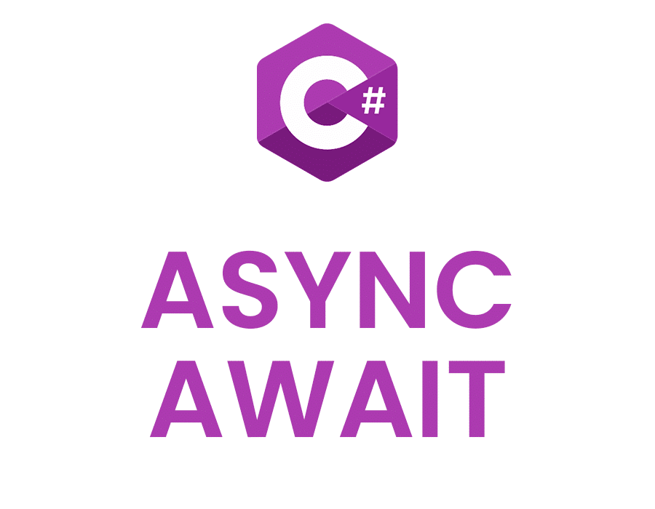
“Async” and “await” keyword
“Async” : Marks a method as asynchronous. This allows us to use “await” inside it. It must return Task , Task<T> or Void in return .
“Await” : Pauses the execution of the method until the awaited task completes — without blocking the thread.
Important: async itself does not make a method run on a background thread. It simply enables the await pattern within it.

Slide 27
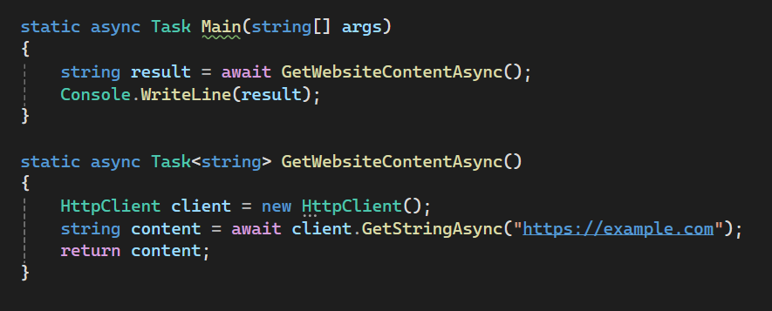
“Async” and “await” keyword(2)
async Task<string>: Declares an async method that returns a string via Task<string>.
await: Waits for the HTTP request to complete without blocking the main thread.
Main method is also marked async in C# 7.1+ to allow await inside it.

Slide 28
Use cases of Asynchronous Programming💪
Desktop Applications (UI Responsiveness)
Use Case: Loading data from a web API or file on app startup.
Async: Keeps the UI responsive while waiting for data.
Sync: Freezes the UI (bad UX), causing the app to appear "hung."
Web APIs / ASP.NET Core
Use Case: Fetching data from a database or calling external APIs.
Async: Frees up threads to handle other requests , scales better under load.
Sync: Blocks server threads, limiting concurrent request handling.
File I/O in Background Tasks
Use Case: Reading/writing large files.
Async: Reads files in chunks without locking up the thread.
Sync: Halts the calling thread, potentially locking the app.

Slide 29
Async Workflow
An async workflow in C# refers to the structured flow of execution in asynchronous code, using async and await to handle tasks that take time like I/O, network calls, or delays without blocking the main thread.
It is basically the execution flow within an async method .
Enables scalable and responsive applications .

Slide 30
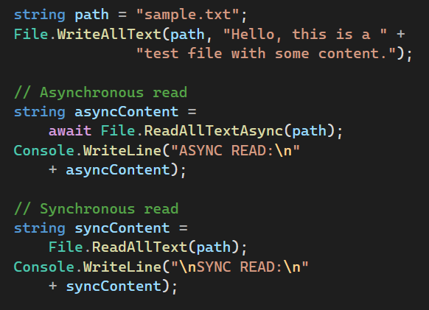
Async File Access
Here's what happens step-by-step ⇒
The async method starts on a thread.
It hits the await on the async file read.
Instead of blocking that thread, the method saves its state (where it left off) and returns the thread to the thread pool,
It waits for the file to finish loading in the background.
When the file is ready, the system picks any available thread, not necessarily the original one , resumes the method from where it left off .

Slide 31
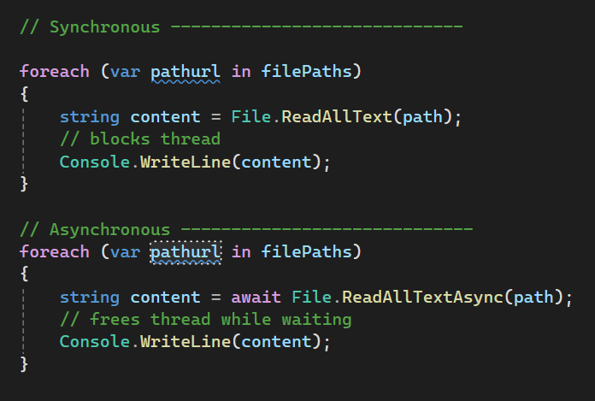
Async File Access in a loop
1. Synchronous loop : Reads files one by one, blocking the thread on each file read
2. Async + await loop : Reads files one by one, but thread freed during waits . It is non-blocking, sequential async file reads

Slide 32
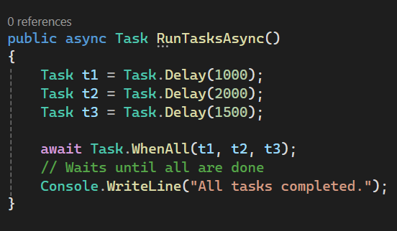
Task.WhenAll()
Task.WhenAll() is a powerful method in C# used to run multiple tasks concurrently and wait for all of them to complete. It returns a single task that completes when all the supplied tasks are finished.
Exceptions: If any task fails, Task.WhenAll() throws an AggregateException with all errors.
Syntax : Task.WhenAll(params Task[] tasks) → void
Task<TResult[]> Task.WhenAll<TResult>(params Task<TResult>[] tasks)

Slide 33
Task.WhenAll() ╰┈➤ pros and cons
PROS :✅
Fastest: All tasks start at once → overall time = longest task only.(MAX(t1,t2,t3,...))
Best performance when tasks are independent.
Great for parallel I/O (e.g., reading files, API calls).
Easy to aggregate results (await Task.WhenAll(...) returns an array).
CONS : ❌
Hard to control order of execution or results.
Error handling is more complex: all exceptions are wrapped in an AggregateException.
Can overwhelm system resources if too many tasks are fired at once (e.g., hundreds of file reads).

Slide 34
ConfigureAwait(false)
ConfigureAwait(false) is used in asynchronous programming in C# to prevent capturing the current synchronization context when resuming after an await.
Syntax : await SomeAsyncMethod().ConfigureAwait(false);
By default, after an await, the continuation (next line of code) tries to run on the same context that started it → often the UI thread in desktop/mobile apps or the request context in ASP.NET.
ConfigureAwait(true) (default): Resume on the original context.
ConfigureAwait(false): Resume on a ThreadPool thread, not the original context.
Use Cases for ConfigureAwait(false)
Library code: No need to get back to a specific thread (e.g., UI).
Performance: Avoids context switching, improving efficiency.
Don't Use in: UI code (WPF, WinForms, Xamarin): If we need to update the UI after await, ConfigureAwait(false) should be avoided .

Slide 35
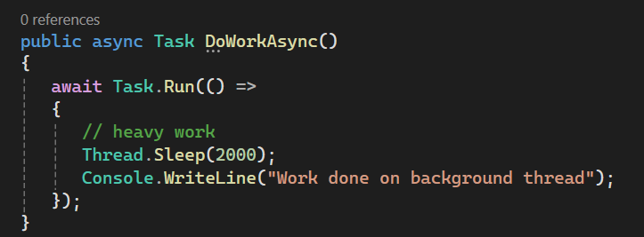
Task.Run()
Task.Run() is a method used to run code on a background thread, offloading it from the main thread. It schedules work to be done on the ThreadPool, making it useful for
performing CPU-bound operations
wrapping synchronous code in an asynchronous context.
Syntax : Task.Run(() => {
// code
});
Task<int> task = Task.Run(() => {
return 21 ;
});
When i returns a value

Slide 36
Task.Run() use cases
sl.no | Task.Run() use | Don’t use
1. | Offloading CPU-bound work (e.g., heavy calculations) | We're calling I/O-bound async methods (e.g., HttpClient)
2. | Keeping UI thread responsive in desktop apps | We're in ASP.NET Core or server code (uses thread pool efficiently)
3. | Migrating legacy sync code to async patterns | The method is already async and doesn't block

Slide 37
Asynchronous Programming Summary
1
2
3
Async programming allows non-blocking code execution using async and await, improving responsiveness and scalability, especially in I/O-bound scenarios.
Commonly used for web requests, file I/O, and database access, async programming prevents UI freezing and enhances server efficiency by avoiding thread blocking during long operations.
It uses Task and Task<T> to represent operations that run in the background, freeing up the main thread (e.g., UI or web server) to handle other work.

Slide 38
THANK YOU

